Slide 1
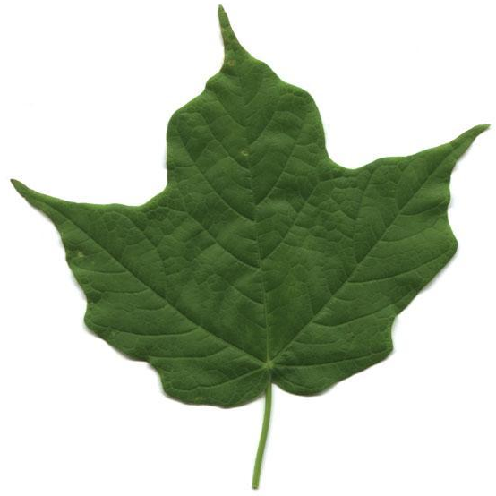
Plant Tissues

Slide 2
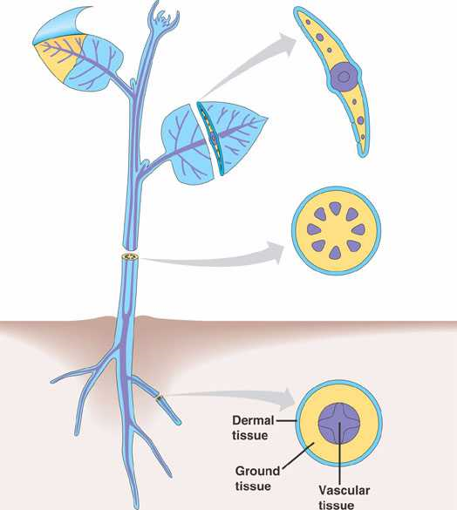
Plant Tissues
Tissue
Collection of cells with a
similar function.
Plant Tissues
Dermal
Ground
Vascular

Slide 3
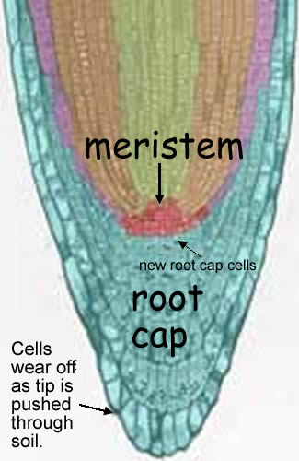
Meristematic Cells
Unspecialized.
Divide and differentiate into
specialized tissues.
Notes:
*

Slide 4
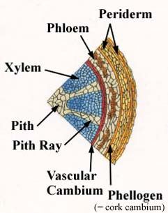
Meristematic Cells
Plant growth via mitosis only at meristems.
Primary Growth (Length)
Occurs at apical meristems
(tips of shoot, leaves and roots).
Secondary Growth (Width)
Vascular cambium
(between xylem & phloem in dicots).
Grows new xylem & phloem.
Cork cambium (outer layer of woody stem).
Grows new cork.
Notes:
Vascular cambium – new xylem on interior and phloem on its exterior
Cork in woody stem
Meristematic tissue known as meristems (regions where growth occurs)
*

Slide 5
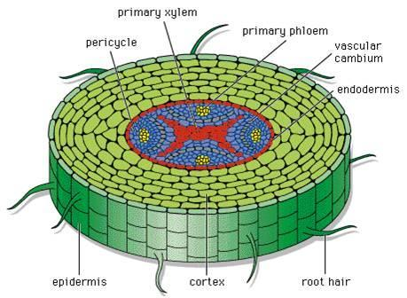
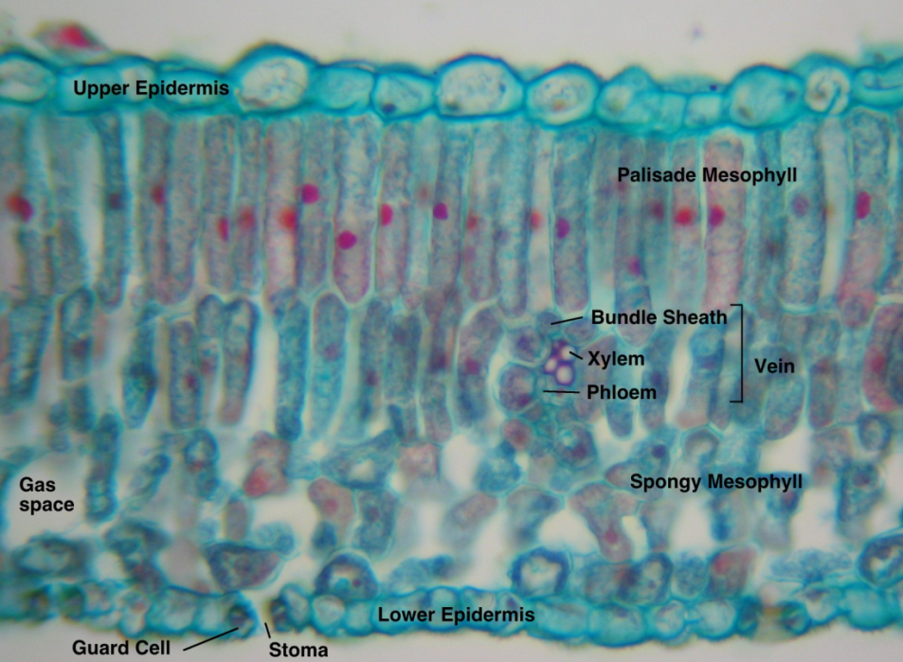
Dermal Tissue
Forms outermost layer of a plant.
Epidermis can be specialized:
Form root hairs to absorb water and minerals.
Produce a waxy waterproof cuticle on leaves.
Notes:
*

Slide 6
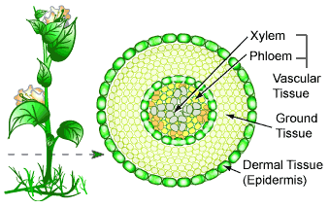
Ground Tissue
Located between the dermal and vascular tissue.
Perform a variety of functions:
Photosynthesis.
Food and water storage.
Structural support.
Notes:
*

Slide 7
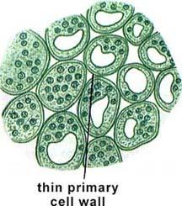
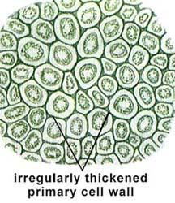
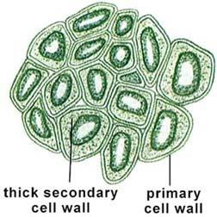
Ground Tissue
Parenchyma
Photosynthetic.
Carry out metabolic reactions.
Food and water storage.
Collenchyma
Structural support where growth occurs.
Sclerenchyma
Structural support.
Notes:
Parenchyma –flesh of apple, radish, watermelon, potato
A generalized plant cell type, parenchyma cells are alive at maturity. They function in storage, photosynthesis, and as the bulk of ground and vascular tissues. Palisade parenchyma cells are elongated cells located in many leaves just below the epidermal tissue. Spongy mesophyll cells occur below the one or two layers of palisade cells. Ray parenchyma cells occur in wood rays, the structures that transport materials laterally within a woody stem. Parenchyma cells also occur within the xylem and phloem of vascular bundles. The largest parenchyma cells occur in the pith region, often, as in corn (Zea ) stems, being larger than the vascular bundles. In many prepared slides they stain green.
The cortex of roots generally consists of parenchyma cells with large intercellular air spaces. The endodermis (the innermost layer of the cortex adjacent to the pericycle) is composed of closely packed cells that have within their walls Casparian strips, water-impermeable deposits of suberin that regulate water and...
The pericycle is a cylinder of parenchyma is a cylinder of parenchyma cells that lies just inside the endodermis is a cylinder of parenchyma cells that lies just inside the endodermis and is the outer most part of the stele of plants.
Collenchyma cells support the plant. These cells are characterized by thickenings of the wall, they are alive at maturity. They tend to occur as part of vascular bundles or on the corners of angular stems. In many prepared slides they stain red. The petiole ("stalk") of leaves is usually reinforced with collenchyma.
Sclerenchyma is found in stems and also in leaf veins. [View] Sclerenchyma also makes up the hard outer covering of seeds and nuts. Some sclerenchyma cells occur in the fruits of Pear. These cells (sclereids or stone cells) give pears their gritty texture.
*

Slide 8
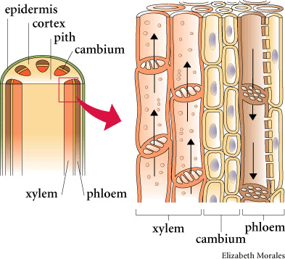
Vascular Tissue
Xylem
Transports water and dissolved minerals from the roots to the leaves.
Phloem
Transports sugar solution from the leaves to the roots.
Notes:
*

Slide 9
Vascular Tissue
Xylem
Vessel elements (angiosperms)
Tracheids (gymnosperms)
Dead cells arranged end to end (perfora) and side by side (pit).
Notes:
Xylem consists of a "pipeline" of dead cells arranged end to end for water and mineral transport. When the cells that form xylem die at maturity, the nucleus and cytoplasm disintegrate, leaving a hollow tunnel. The leftover cell walls are very thick and provide support for the plant; the cavities inside provide a passage through which fluids can move. The xylem carries water and dissolved minerals upward from the roots through the stem and leaves of the plant. In larger seed plants, xylem cells are specialized into vessel elements and tracheids. Vessel elements are found in flowering plants (angiosperms), and are wider and better at conducting water than the tracheids of conifers (gymnosperms).
*

Slide 10
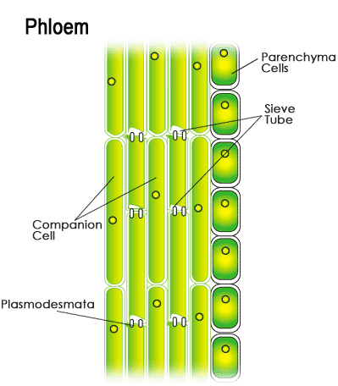
Vascular Tissue
Phloem
Sieve tube
Interconnected with perforations.
Lack nuclei.
Companion cells
Actively transports sugars into & out of sieve tubes.
Notes:
The main components of phloem are sieve elements and
companion cells.
Sieve elements are so-named because their end walls are perforated. This allows cytoplasmic connections between vertically-stacked cells. The result is a sieve tube that conducts the products of photosynthesis - sugars and amino acids - from the place where they are manufactured (a "source"), e.g., leaves, to the places ("sinks") where they are consumed or stored; such as
roots
growing tips of stems and leaves
flowers
fruits, tubers, corms, etc.
Sieve elements have no nucleus and only a sparse collection of other organelles. They depend on the adjacent companion cells for many functions.
Companion cells move sugars and amino acids into and out of the sieve elements. In "source" tissue, such as a leaf, the companion cells use transmembrane proteins to take up - by active transport - sugars and amino acids from the cells manufacturing them. Water follows by osmosis manufacturing them. Water follows by osmosis. These materials then move into adjacent sieve elements by diffusion manufacturing them. Water follows by osmosis. These materials then move into adjacent sieve elements by diffusion through plasmodesmata. The pressure created by osmosis drives the flow of materials through the sieve tubes. In "sink" tissue, the sugars and amino acids leave the sieve tubes by diffusion through plasmodesmata connecting the sieve elements to the cells of their destination. Again, water follows by osmosis where it may
leave the plant by transpiration or
increase the volume of the cells or
move into the xylem for recycling through the plant.
*

Slide 11
Useful Links
http://www.sparknotes.com/biology/plants/plantclassification/section2.rhtml
Notes:
*

