Slide 1
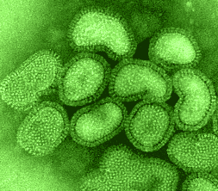
Viruses
Slow motion sneezing (1:36 min)
Zika Virus
Ebola
Notes:
‹#›

Slide 2
Is a virus alive?
Common Characteristics:
move
can’t respond to stimuli
can’t develop (grow)
contain complex components
die (destroyed)
Fundamental Characteristics:
not made of cells
no metabolism
can’t reproduce (without infecting a living host)
can reproduce within a host and kill it
no homeostasis
Since viruses don’t have all the fundamental characteristics of life, and they must rely on other living things, they are not quite alive.

Slide 3
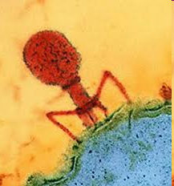
So what are Viruses?
small, infectious, non-living, non-cellular particles
contain no cytoplasm
cannot grow or reproduce on their own (need a host)
do not produce or use energy
do not create waste
do have genetic material which takes control of other cells to create “virus copies”

Slide 4
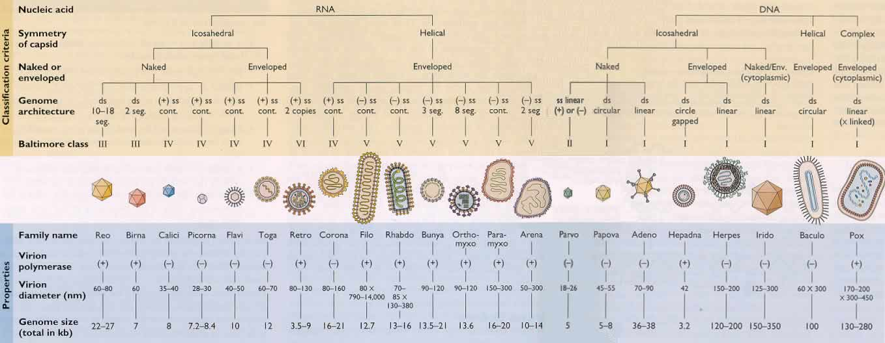
Classifying Viruses
they are classified into orders, families, genera and species based on size, shape, and type of genetic material
about 4000 have been classified but scientists think there may be millions!

Slide 5
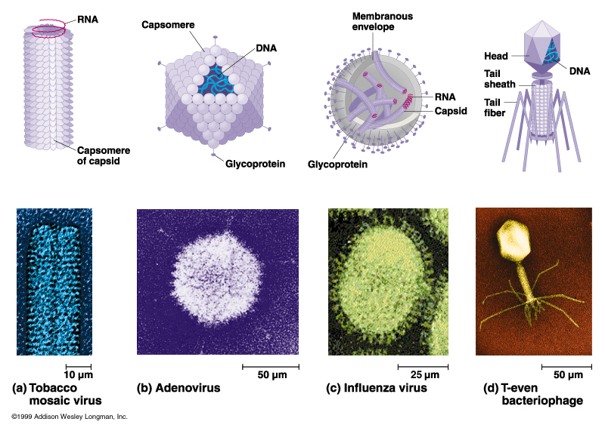
Diagrams of Viruses

Slide 6
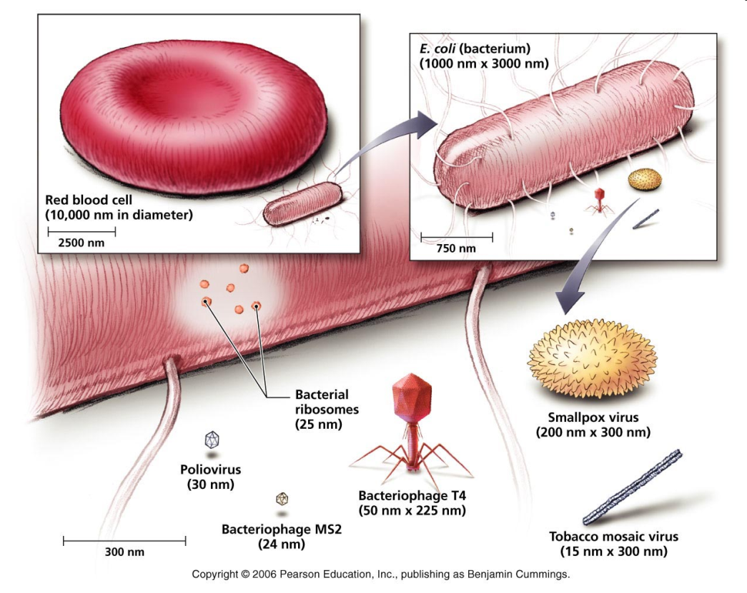
Size of Viruses
less than 0.1 µm in diameter
Hundreds of thousands can fit inside a typical human cell.
The Scale of the Universe

Slide 7
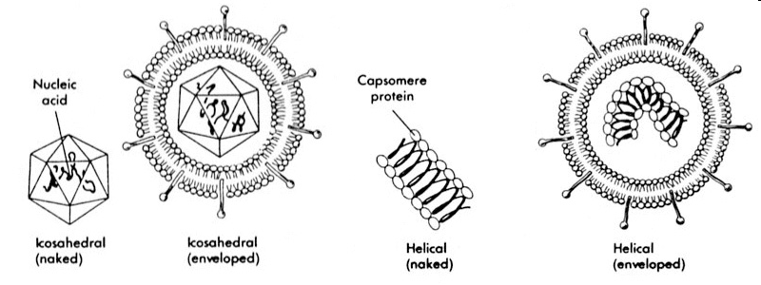
Basic Structure of a Virion (a virus particle)
Genetic material– RNA (ss) or DNA (ds) core
Capsid (or head) – protein coat that surrounds and protects the genetic material
Note: Some viruses are surrounded by an envelope, which is created when a virus leaves a host cell and part of the host cell membrane wraps around the virus.
Notes:
(ss) = single strand, (ds)= double strand

Slide 8
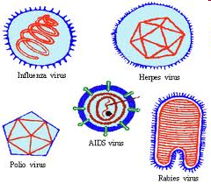
RNA or DNA?
Viruses with RNA
has RNA (ribonucleic acid) as its genetic material
usually single-stranded RNA
very high mutation rates because during replication not proof-read the same as DNA
due to high mutation rate, vaccines are not as effective
Examples: Human immunodeficiency virus (HIV), Influenza viruses, Rabies, Measles, mumps, pneunomia, polio, common cold, SARS
Viruses with DNA:
has DNA (deoxyribonucleic acid)
usual double-stranded
lower mutation rates because of proofreading
more constant/stable so vaccines are effective
Examples: Chickenpox, cold sores, genital herpes, Mononucleosis, Hepatitis, Adenovirus (Respiratory infections, tumours)

Slide 9
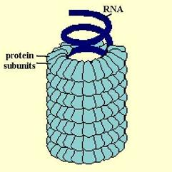
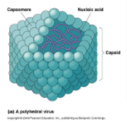
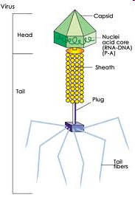
Virus Shapes
1) Helical
rod-like with capsid proteins winding around
the core in a spiral
Ex. Tobacco Mosaic Virus
2) Polyhedral
- has many sides
- most polyhedral capsids have 20 sides and
12 corners
- Ex. adenovirus (causes respiratory infections,
diarrhea, pink eye)
3) Complex - Polyhedral capsid attached to a helical tail
- The tail is made of protein, which aids in binding to host cells.
- This is the typical structure of Bacteriophages
(viruses that attack bacteria).
Notes:
‹#›

Slide 10
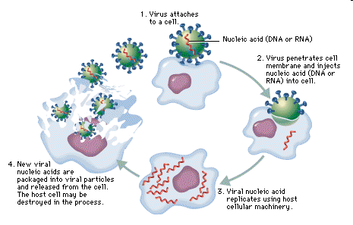
2 methods of Viral replication: (also called Infectious Cycles)
1) Lytic Cycle
the virus enters the cell, replicates itself hundreds of times, and then bursts out of the cell destroying it
1. Attachment
2. Injection/Entry
3. Replication
4. Assembly
5. Release
(lysis = breaking open)
Lytic Cycle (1:16 min): http://www.youtube.com/watch?v=wVkCyU5aeeU&feature=related
Retrovirus (1:39 min): http://www.youtube.com/watch?v=dn1tNIrMPRk&feature=related
Notes:
‹#›

Slide 11
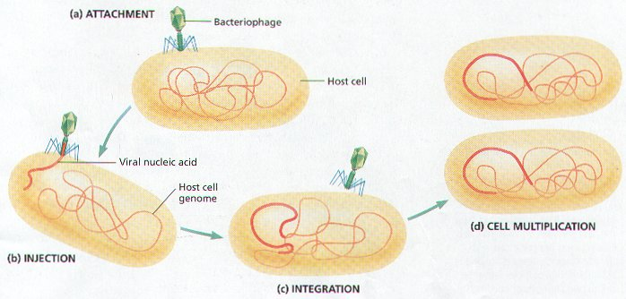
Lysogenic Cycle
the virus enters the cell, viral DNA integrates with the host DNA and becomes inactive, the host functions normally
an environmental change may then cause the virus to enter the Lytic Cycle
1. Attachment
2. Injection/Entry
3. Integration into host cell’s DNA
4. Dormancy/Normal cell functions
5. Triggering of viral DNA to be
released and then Lytic cycle begins
Lysogenic Cycle (1:26 min): http://www.youtube.com/watch?v=_J9-xKitsd0&feature=related

Slide 12
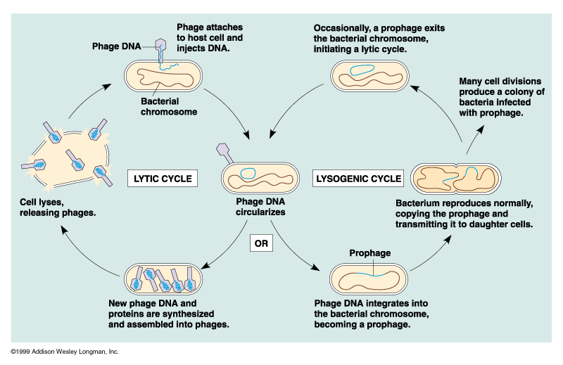
The lambda phage which infects E. coli demonstrates the cycles of a temperate phage.
1

Slide 13
Differences Between Lytic & Lysogenic Cycles
In the Lytic Cycle:
Viral DNA destroys Cell DNA, takes over cell functions and destroys the cell.
The virus replicates and produces progeny phages.
There are symptoms of viral infection.
In the Lysogenic Cycle:
Viral DNA merges with cell DNA and does not destroy the cell.
The virus does not produce progeny.
There are no symptoms of viral infection.
http://www.brighthub.com/science/genetics/articles/30611.aspx

Slide 14
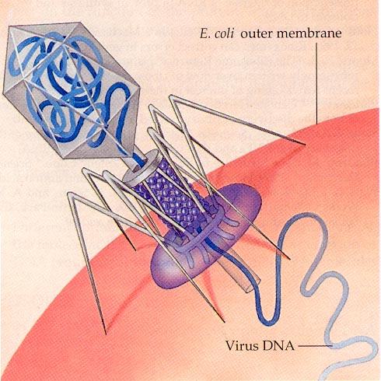
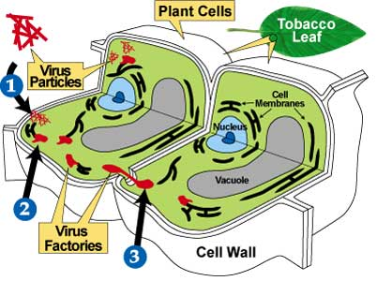
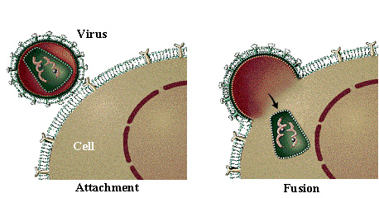
3 ways Viruses enter living cells:
Enter bacterial cells by punching a hole
in the cell wall and injecting its DNA.
Enter plant cells through tiny rips in the cell wall.
Enter animal cells by endocytosis.
Notes:
‹#›

Slide 15
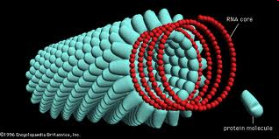
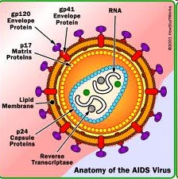
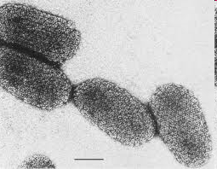
Viruses are host cell specific
can usually infect one type of host or even an organ, tissue or cell type (called its HOST RANGE)
a protein on the surface of the virus has a shape that matches a molecule in the plasma membrane of its host, allowing the virus to lock onto the host cell (like a key fits in a lock)
Examples:
- a plant virus can only attack a plant cell and not
an animal cell
- HIV (human immunodeficiency virus) infects only certain immune system cells
some viruses can infect many species
Examples:
- rabies (rhabdovirus) – infects all birds and mammals
- swine flu virus can infect swine or humans

Slide 16
How are viruses spread?
VECTORS - carry the virus from one host to another
Vectors include:
Insects (yellow fever – mosquitos)
Animals (rabies)
Water (polio)
Air (influenza, common cold, chicken pox)
Humans (influenza, hepatitis, HIV)
Flu Attack! How a virus invades your body (3:34 min) http://www.youtube.com/watch?v=Rpj0emEGShQ

Slide 17
Epidemic or Pandemic?
Epidemic:
a large-scale outbreak of disease; usually confined to a limited geographic region
e.g./ 2003 SARS, 800 people died (worldwide)
Pandemic:
an epidemic that occurs over a widespread geographic area, often globally
e.g./ Spanish influenza killed 40-50 million people in 1918

Slide 18
Learn more about a disease
Select either a bacterial disease or a viral disease and research the following information:
Bacterial Disease | Viral Disease
Size of bacteria cell Shape of bacteria (coccus, bacillus, spirillum) Grouping (mono, di, strepto, staphylo) Diagram of bacteria Gram + or gram - Type of movement Type of respiration (aerobic, anaerobic, etc) Method of reproduction Type of organism impacted Who is impacted the most | Size of virus Classification Diagram of virus RNA or DNA virus Shape of virus Is it possible for this virus to enter the lysogenic cycle? How does it enter living cells? Host organisms Who is impacted the most

